Slide 1
Digital Jumpstart
A primer for a 6th grade science text.

Slide 2
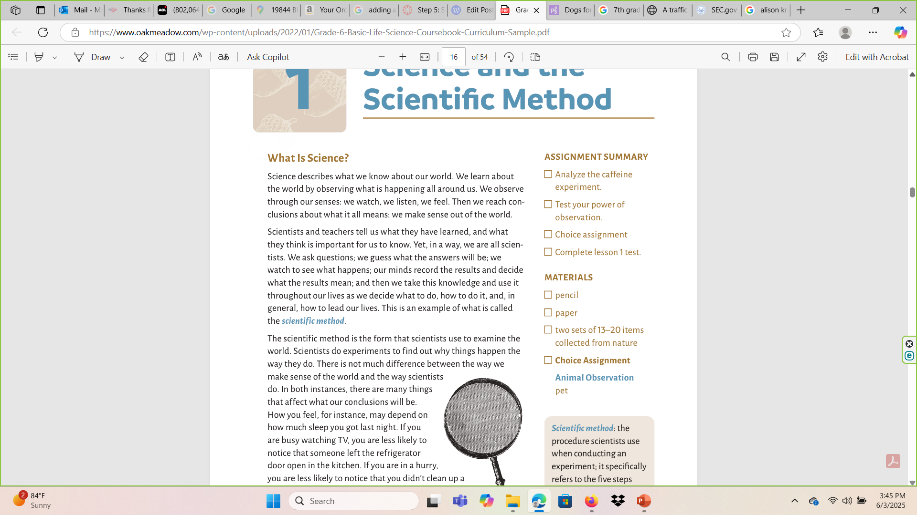
Our 6th grade science text from https://www.oakmeadow.com/wp-content/uploads/2022/01/Grade-6-Basic-Life-Science-Coursebook-Curriculum-Sample.pdf

Slide 3

Science
Our text tells us “We learn about the world by observing what is happening all around us. We observe through our senses: we watch, we listen, we feel. Then we reach conclusions about what it all means: we make sense out of the world.”

Slide 4
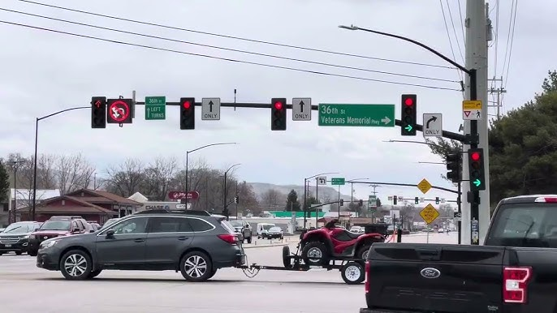
In Our Everday Life
We may notice the traffic lights on our way to school seem to be in a form of unison. Is this coincidence?

Slide 5
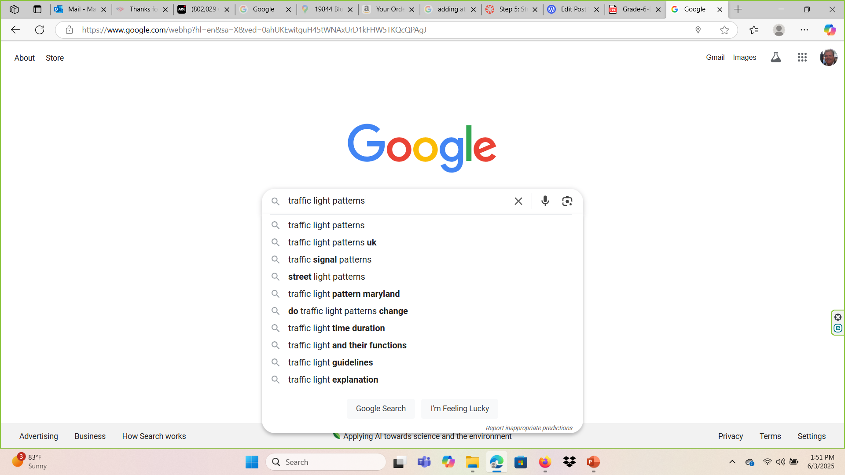
Let’s Investigate

Slide 6
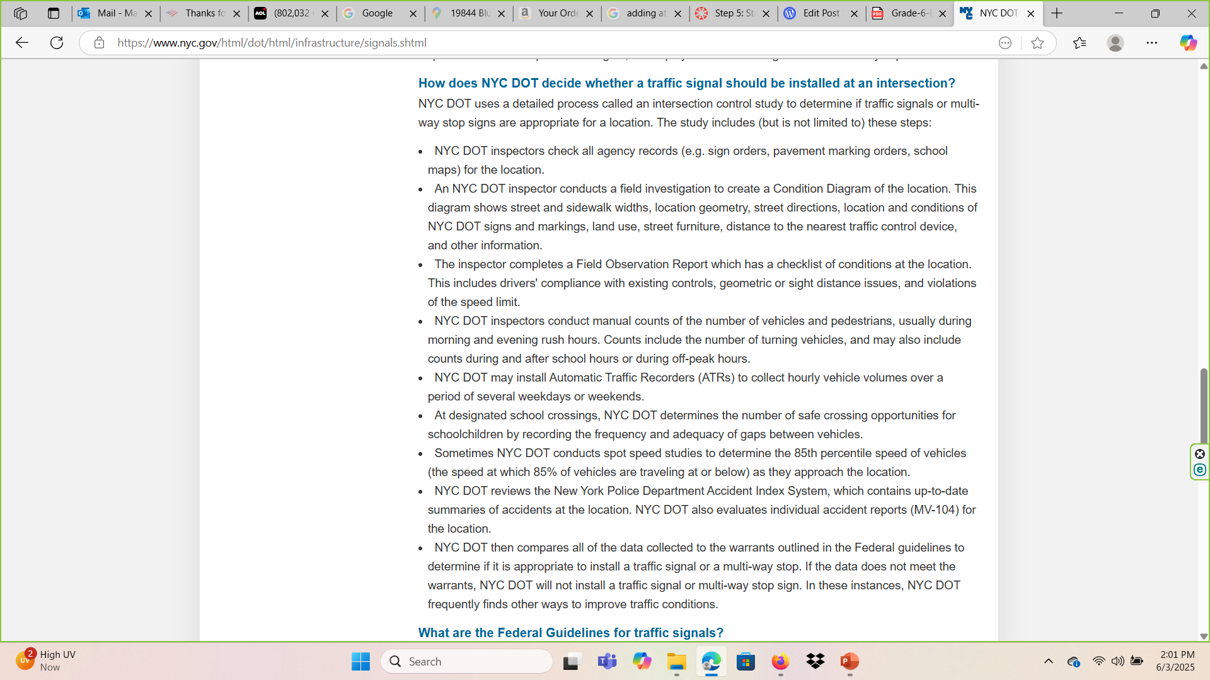
So This is How Thet Study Traffic Patterns in New York City. Interesting ..

Slide 7
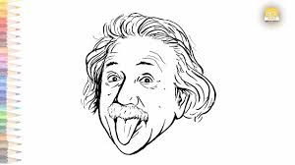
Scientists
Our text tells us “Scientists and teachers tell us what they have learned, and what they think is important for us to know.”

Slide 8
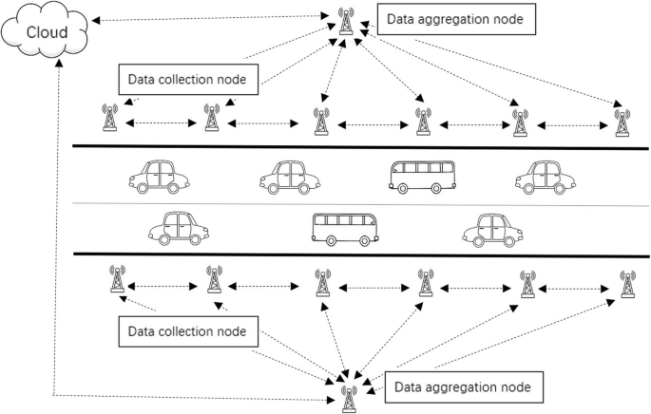
A data analysis method based on incremental noise addition is proposed in the paper for traffic flow data, which provides a criterion for chaotic identification.

Slide 9
So, we observed traffic patterns, at least with signals.
We researched how it was done and discovered New York City’s methodology.
Finally, thus far we discovered scientists have developed controlled testing to study traffic patterns which may back up our research.
Fascinating discovery of what we experience routinely in our lives.

Slide 10
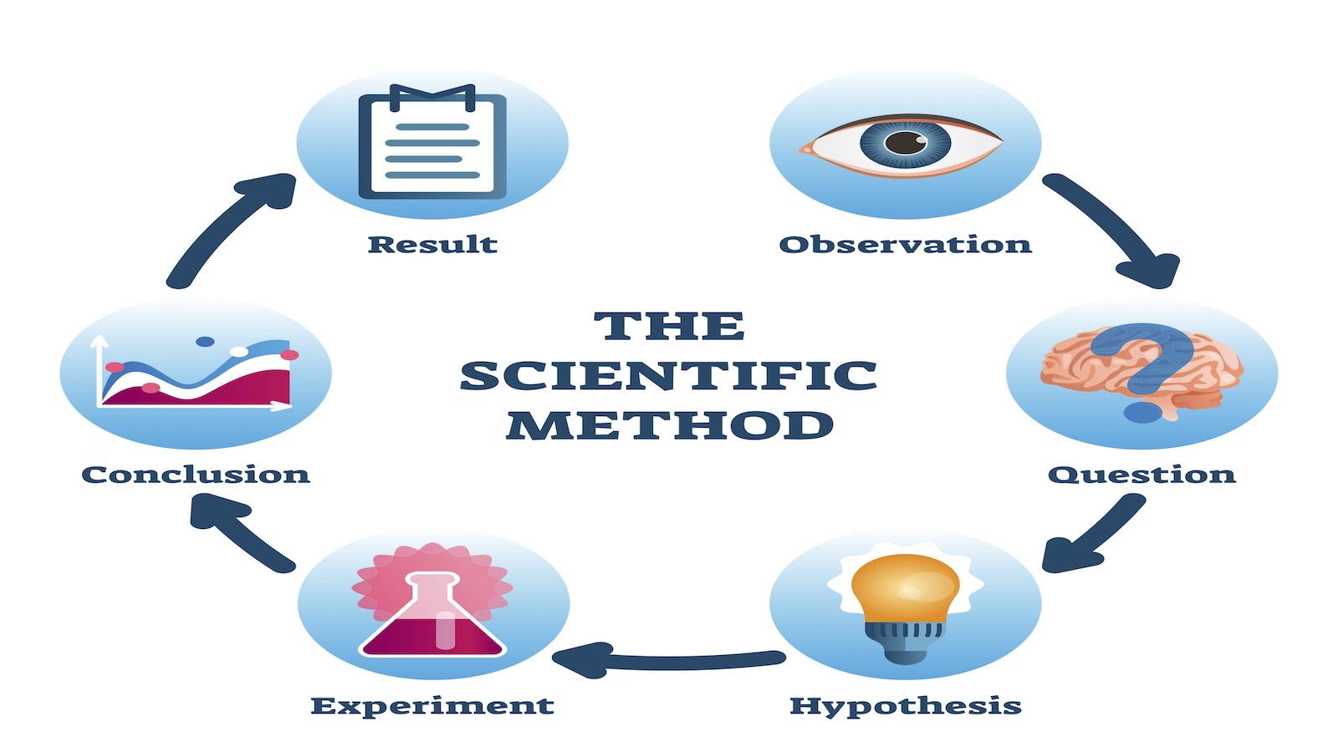
Scientific Method
This all began with an observation of traffic lights on our way to school, correct?

Slide 11
Our text states “trying to determine the effect of a particular factor on something or a specific effect or situation.
Therefore, a scientist will try to set up a controlled experiment to test the effect of a particular thing on something else.”

Slide 12
We observed traffic patterns which induced questions. We researched and discovered a metropolitan area’s method for observing traffic patterns in an effort to answer our question of how traffic signals may be synchronized.
We discovered scientists use scientific method to create controlled environments which should produce true and repeatable results.
This is a real-life example of what we are about to learn in our text.
Enjoy!

